Slide 1
Solving Linear Programming Problems: The Simplex Method
Chapter 4

Slide 2
4.1 The Essence of the Simplex Method
Algebraic procedure
Underlying concepts are geometric几何
Revisit Wyndor example
Figure 4.1 shows constraint boundary lines
Points of intersection are corner-point solutions
Five points on corners of feasible region are CPF solutions
Adjacent CPF solutions
Share a constraint boundary

Slide 3
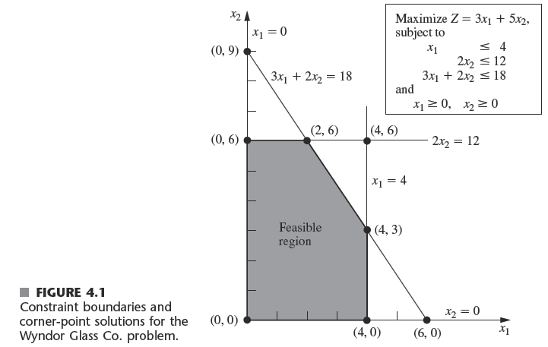
The Essence of the Simplex Method

Slide 4
The Essence of the Simplex Method
Optimality test
If a CPF solution has no adjacent CPF solution that is better (as measured by Z):
It must be an optimal solution
Solving the example with the simplex method
Choose an initial CPF solution (0,0) and decide if it is optimal
Move to a better adjacent CPF solution
Iterate until an optimal solution is found

Slide 5
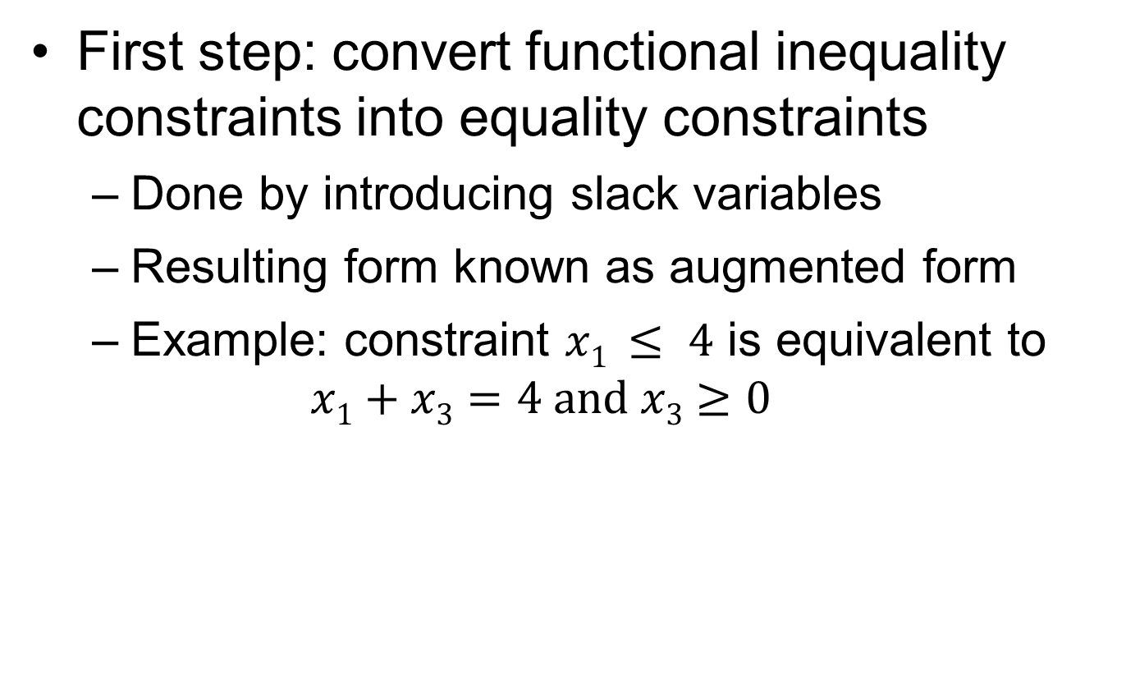
4.2 Setting Up the Simplex Method
First step: convert functional inequality constraints into equality constraints
Done by introducing slack variables
Resulting form known as augmented form
Example: constraint $x1 ≤ 4$ is equivalent to
$$x1+x3=4 and x3≥0$$

Slide 6
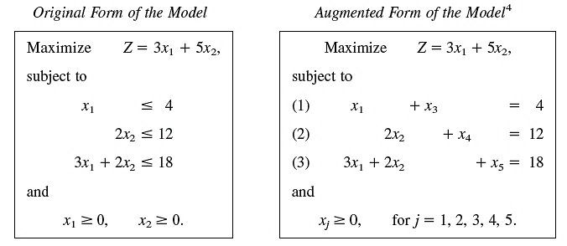
Setting Up the Simplex Method

Slide 7
Setting Up the Simplex Method
Augmented solution扩展模式
Solution for the original decision variables augmented by the slack variables
Basic solution
Augmented corner-point solution
Basic feasible (BF) solution
Augmented CPF solution角点解

Slide 8
Setting Up the Simplex Method
Properties of a basic solution
Each variable designated basic or nonbasic 基变量 非基变量
Number of basic variables equals number of functional constraints
The nonbasic variables are set equal to zero
Values of basic variables obtained as simultaneous solution of system of equations
If basic variables satisfy nonnegativity 非负constraints, basic solution is a BF solution

Slide 9
基可行解的定义
考虑标准形式的线性规划问题
基：A是约束方程组的系数矩阵(设n>m)，其秩为m，B是A中的一个m阶满秩子方阵（ ∣B∣≠0 ），称B是线性规划问题的一个基。
B中每一个列向量称为一个基向量，与基向量对应的变量称为基变量。其余变量称为非基变量。

Slide 10
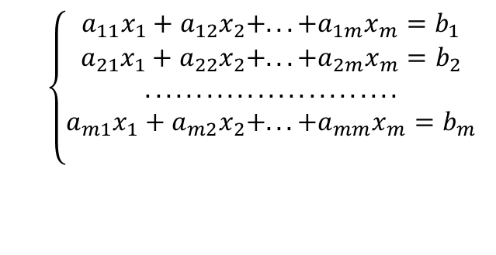
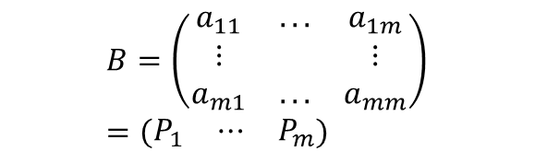
不失一般性，设
$$B=\left(\begin{matrix}a_{11} & ... & a_{1m} \\ ⋮ & & ⋮ \\ a_{m1} & ... & a_{mm}\end{matrix}\right)=\left(\begin{matrix}P_{1} & ⋯ & P_{m}\end{matrix}\right)$$
则P_{j}（j=1，2…m）是基向量，x_{j}（ j=1，2…m ）是基变量。 x_{j}（ j=m+1，…，n ）是非基变量。
基解：在约束方程组中令所有的非基变量
x_{m+1}=x _{m+2}=x _{n}=0，得
$$\left\{\begin{matrix}a_{11}x_{1}+a_{12}x_{2}+...+a_{1m}x_{m}=b_{1} \\ a_{21}x_{1}+a_{22}x_{2}+...+a_{2m}x_{m}=b_{2} \\ ......................... \\ a_{m1}x_{1}+a_{m2}x_{2}+...+a_{mm}x_{m}=b_{m} \\ \end{matrix}\right.$$
此方程组有唯一解X_{B}=(x₁，x₂，…x_{m})^{T}，将这个解加上非基变量取0的值有X=(x₁，x₂，…x_{m},0,…,0)^{T},称X为线性规划问题的基解。

Slide 11
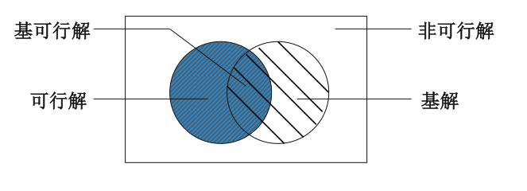
显然，基解中取非零值的变量个数不超过m，基解的总数不超过C_{n}^{m}个。
基可行解：满足非负约束的基解称为基可行解。
可行基：对应于基可行解的基。

Slide 12

Setting Up the Simplex Method
x1 = 0 and x4 = 0 nonbasic variables
Because all three of these basic variables are nonnegative, this basic solution (0, 6, 4, 0, 6) is indeed a BF solution.

Slide 13
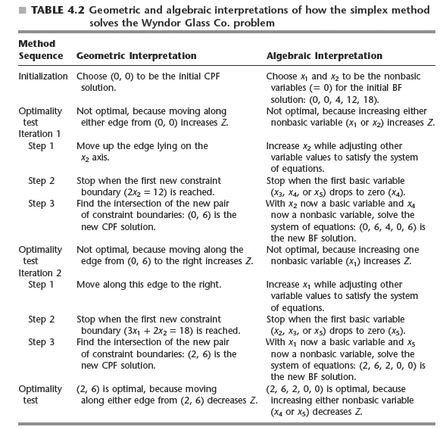
4.3 The Algebra of the Simplex Method

Slide 14
单纯形法步骤
找出一个初始可行解
是否最优
是
最优解
循
环
否
结束
转移到另一个基本可行解
（找出更大的目标函数值）
核心是：变量迭代

Slide 15
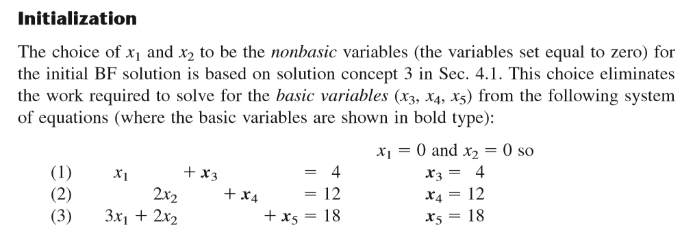
4.3 The Algebra of the Simplex Method
Initial BF solution is (0, 0, 4, 12, 18)

Slide 16

4.3 The Algebra of the Simplex Method
Optimality Test
Initial BF solution (0, 0, 4, 12, 18) is not optimal

Slide 17
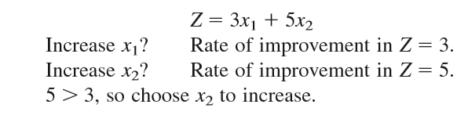
4.3 The Algebra of the Simplex Method
Determining the Direction of Movement (Step 1 of an Iteration)
X2 is called the entering basic variable 入基变量

Slide 18
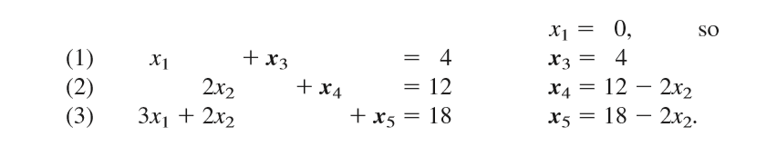
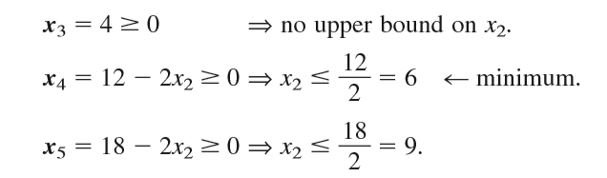
4.3 The Algebra of the Simplex Method
Determining Where to Stop (Step 2 of an Iteration)
These calculations are referred to as the minimum ratio test

Slide 19
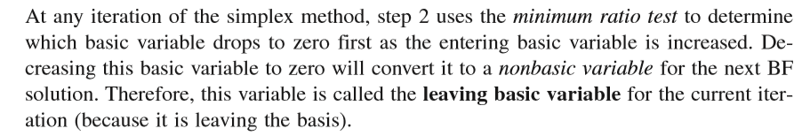
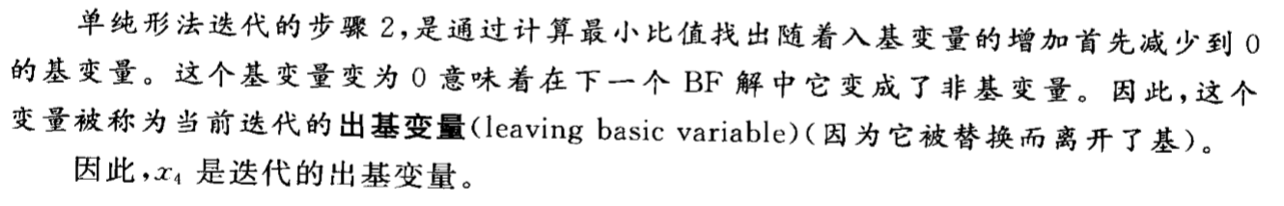
4.3 The Algebra of the Simplex Method
Determining Where to Stop (Step 2 of an Iteration)

Slide 20
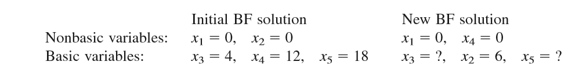
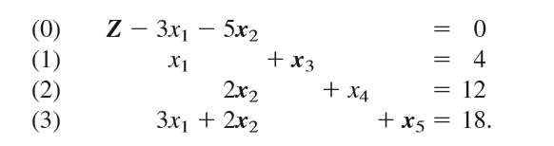
4.3 The Algebra of the Simplex Method
Solving for the New BF Solution (Step 3 of an Iteration)
Z, x2, x3, and x5： basic variable

Slide 21
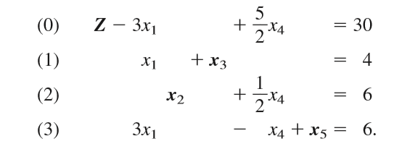
4.3 The Algebra of the Simplex Method
Solving for the New BF Solution (Step 3 of an Iteration)
elementary algebraic operations
New BF solution

Slide 22

4.3 The Algebra of the Simplex Method
Optimality Test for the New BF Solution
Increasing x1 would lead to an adjacent BF solution that is better than the current BF solution, so the current solution is not optimal

Slide 23
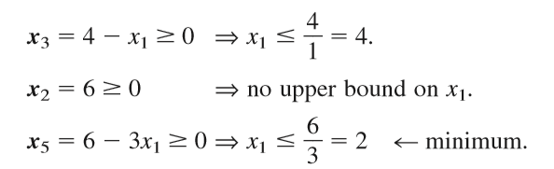
4.3 The Algebra of the Simplex Method
Iteration 2 and the Resulting Optimal Solution
x5 is the leaving basic variable

Slide 24
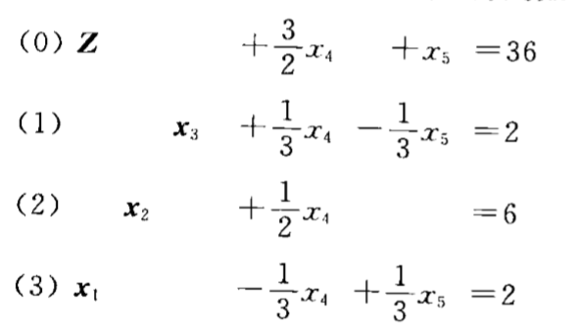
4.3 The Algebra of the Simplex Method
Iteration 2 and the Resulting Optimal Solution

Slide 25

4.3 The Algebra of the Simplex Method
Iteration 2 and the Resulting Optimal Solution
Optimal solution is x1 = 2, x2 = 6, which yields Z = 3x1 + 5x2 =36

Slide 26
4.4 The Simplex Method in Tabular Form
Tabular form表格形式
Records only the essential information:
Coefficients of the variables
Constants on the right-hand sides of the equations
The basic variable appearing in each equation
Example shown in Table 4.3 on next slide

Slide 27
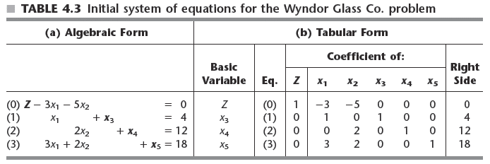
The Simplex Method in Tabular Form

Slide 28
The Simplex Method in Tabular Form
Summary of the simplex method
Initialization
Introduce slack variables
Optimality test
Optimal if and only if every coefficient in row 0 is nonnegative
Iterate (if necessary) to obtain the next BF solution
Determine entering and leaving basic variables
Minimum ratio test

Slide 29
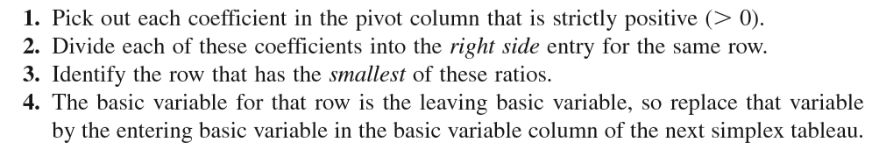
The Simplex Method in Tabular Form
Step 1: Determine the entering basic variable by selecting the variable (automatically a nonbasic variable) with the negative coefficient having the largest absolute. Put a box around the column below this coefficient, and call this the pivot column 枢轴列.
Step2： Determine the leaving basic variable by applying the minimum ratio test最小比值

Slide 30
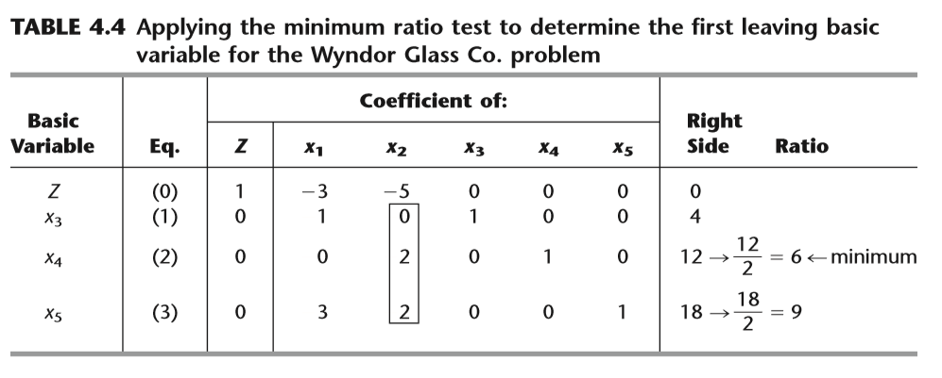
The Simplex Method in Tabular Form

Slide 31
The Simplex Method in Tabular Form
Step 3: Solve for the new BF solution by using elementary row operations (multiply or divide a row by a nonzero constant; add or subtract a multiple of one row to another row) to construct a new simplex tableau in proper form from Gaussian elimination below the current one, and then return to the optimality test.

Slide 32
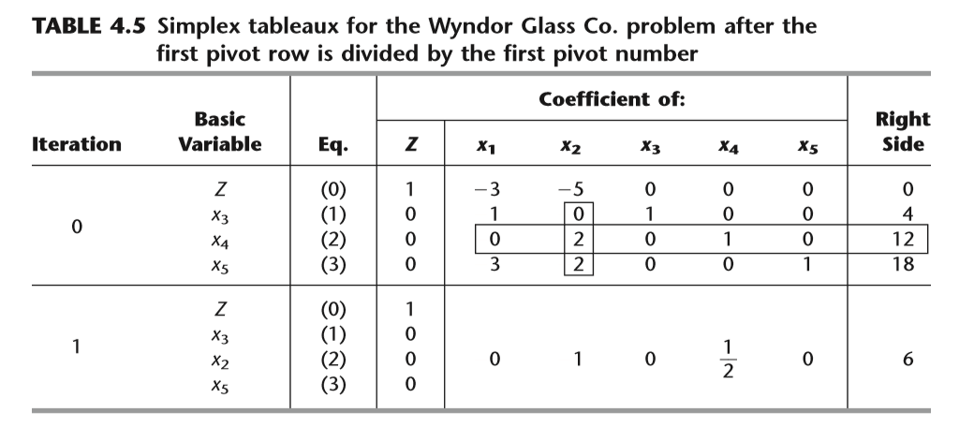
The Simplex Method in Tabular Form

Slide 33
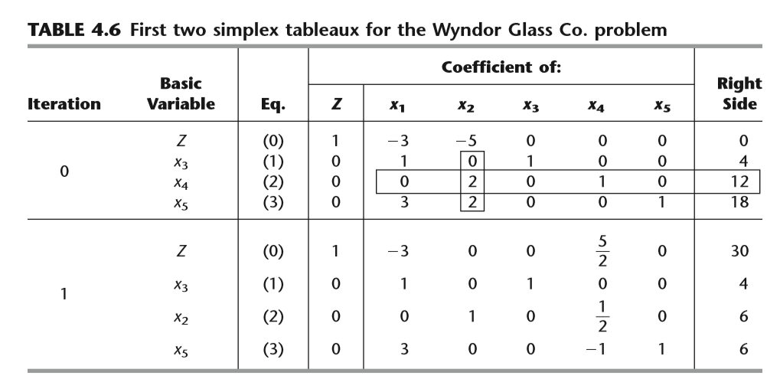
The Simplex Method in Tabular Form

Slide 34
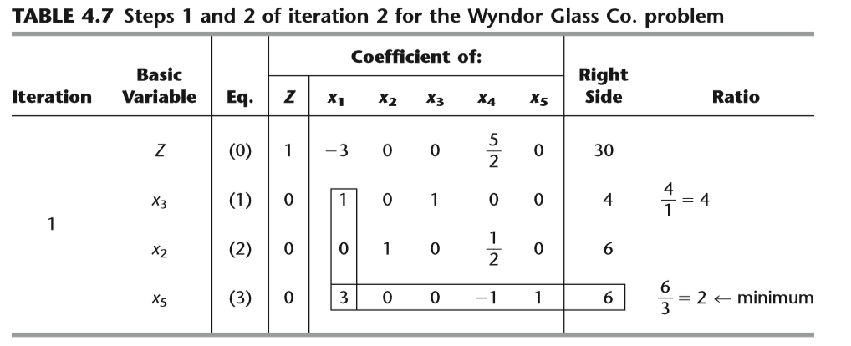
The Simplex Method in Tabular Form

Slide 35
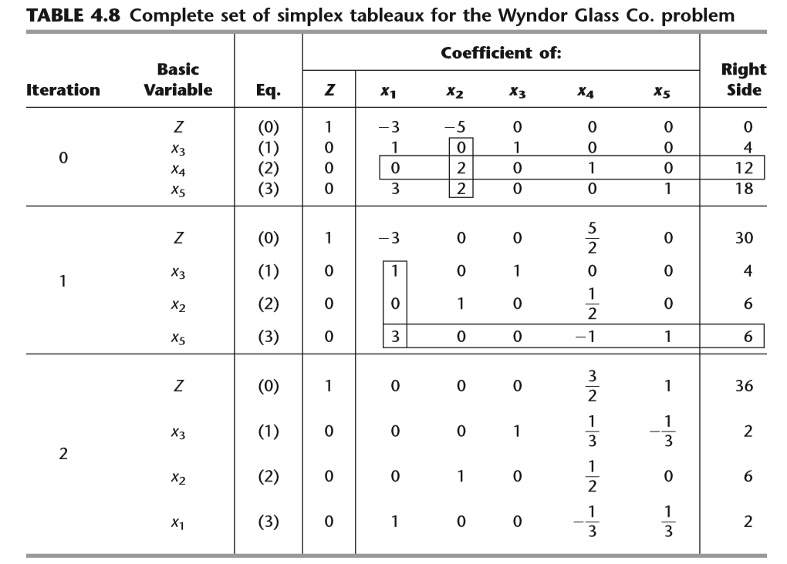
The Simplex Method in Tabular Form

Slide 36
The Simplex Method in Tabular Form
Summary of the simplex method
Step 1 将线性规划问题化成典式,求出各个非基变量的检验数.
Step 2 判断所有非基变量的检验数是否非正,若是,则结束;否则转step 3.
Step 3 选取一个检验数大于零的非基变量为进基变量;
Step 4 若进基变量所对应的约束条件系数全为非正数,则原问题无界,结束;否则,按最小比值原则确定出基变量;
Step 5 进行迭代(用方程组的初等变换法确定新的基对应的典式及检验数),转step 2.

Slide 37
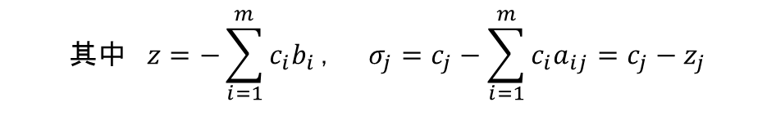
单纯形表
C_{B} | X_{B} | b | c₁ | c₂ |  | c_{m} | c_{m+1} |  |  |  | c_{n}
 |  |  | x₁ | x₂ | … | x_{m} | x_{m+1} |  | … |  | x_{n}
c₁ | x₁ | b₁ | 1 | … |  | 0 | α_{1m+1} |  |  | … | α_{1n}
 | : | : | :
c_{m} | x_{m} | b_{m} | 0 | … |  | 1 | α_{mm+1} |  |  | … | α_{mn}
检验数 |  | z | 0 | 0 | … | 0 | σ_{m+1} |  |  | … | σ_{n}
$$其中 z=−\sum_{i=1}^{m}{c_{i}b_{i}}， σ_{j}=c_{j}−\sum_{i=1}^{m}{c_{i}a_{ij}}=c_{j}−z_{j}$$

Slide 38
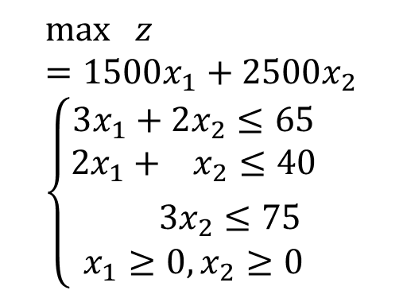
The Simplex Method in Tabular Form
$$\max{ }z=1500x_{1}+2500x_{2} \\ \left\{\begin{aligned}3x_{1}+2x_{2}≤65 \\ 2x_{1}+ x_{2}≤40 \\ 3x_{2}≤75 \\ x_{1}≥0,x_{2}≥0\end{aligned}\right.$$

Slide 39
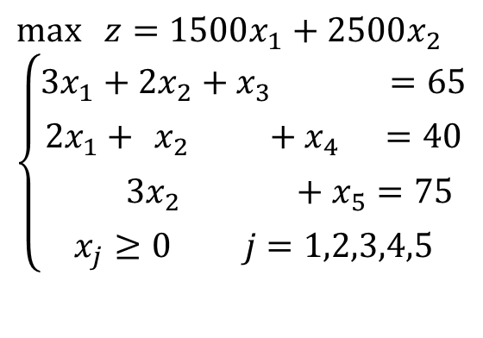
The Simplex Method in Tabular Form
$$\max{ }z=1500x_{1}+2500x_{2} \\ \left\{\begin{aligned}3x_{1}+2x_{2}+x_{3} =65 \\ 2x_{1}+ x_{2} +x_{4} ​=40 \\ 3x_{2} +x_{5}=75 \\ x_{j}≥0 j=1,2,3,4,5\end{aligned}\right.$$

Slide 40
 |  |  | 1500 | 2500 | 0 | 0 | 0
C_{B} | X_{B} | b | x₁ | x₂ | x₃ | x₄ | x₅
0 | x₃ | 65 | 3 | 2 | 1 | 0 | 0
0 | x₄ | 40 | 2 | 1 | 0 | 1 | 0
0 | x₅ | 75 | 0 | 3 | 0 | 0 | 1
θ
32.5
40
25
σ_{j} | 0 | 1500 | 2500 | 0 | 0 | 0
5
7.5
0 | x₃ | 15 | 3 | 0 | 1 | 0 | -2/3
0 | x₄ | 15 | 2 | 0 | 0 | 1 | -1/3
2500 | x₂ | 25 | 0 | 1 | 0 | 0 | 1/3
σ_{j} | -62500 | 1500 | 0 | 0 | 0 | -2500/3
1500 | x₁ | 5 | 1 | 0 | 1/3 | 0 | -2/9
0 | x₄ | 5 | 0 | 0 | -2/3 | 1 | 1/9
2500 | x₂ | 25 | 0 | 1 | 0 | 0 | 1/3
σ_{j} | -70000 | 0 | 0 | -500 | 0 | -500
Optional Solution：（5，25，0,0）
Z：70000

Slide 41
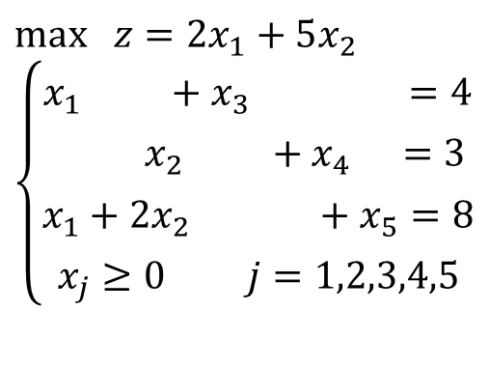
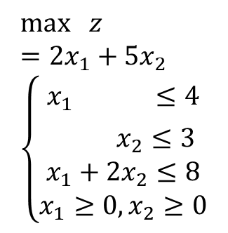
The Simplex Method in Tabular Form
$$\max{ }z=2x_{1}+5x_{2} \\ \left\{\begin{aligned}x_{1} ≤4 \\ x_{2}≤3 \\ x_{1}+2x_{2}≤8 \\ x_{1}≥0,x_{2}≥0\end{aligned}\right.$$
$$\max{ }z=2x_{1}+5x_{2} \\ \left\{\begin{aligned}x_{1} +x_{3} =4 \\ x_{2} +x_{4} ​=3 \\ x_{1}+2x_{2} +x_{5}=8 \\ x_{j}≥0 j=1,2,3,4,5\end{aligned}\right.$$

Slide 42
 |  |  | 2 | 5 | 0 | 0 | 0
C_{B} | X_{B} | b | x₁ | x₂ | x₃ | x₄ | x₅
0 | x₃ | 4 | 1 | 0 | 1 | 0 | 0
0 | x₄ | 3 | 0 | 1 | 0 | 1 | 0
0 | x₅ | 8 | 1 | 2 | 0 | 0 | 1
θ
3
4
σ_{j} | 0 | 2 | 5 | 0 | 0 | 0
4
2
0 | x₃ | 4 | 1 | 0 | 1 | 0 | 0
5 | x₂ | 3 | 0 | 1 | 0 | 1 | 0
0 | x₅ | 2 | 1 | 0 | 0 | -2 | 1
σ_{j} | -15 | 2 | 0 | 0 | -5 | 0
0 | x₃ | 2 | 0 | 0 | 1 | 2 | -1
5 | x₂ | 3 | 0 | 1 | 0 | 1 | 0
2 | x₁ | 2 | 1 | 0 | 0 | -2 | 1
σ_{j} | -19 | 0 | 0 | 0 | -1 | -2
最优解X*=(2,3,0,0,0)^{T}，最优值19。

Slide 43
4.5 Tie Breaking in the Simplex Method
Tie 相持 for the entering basic variable
Decision may be made arbitrarily 任意
Tie for the leaving basic variable
Matters theoretically but rarely in practice同时退化为0
Choose arbitrarily
Condition of no leaving basic variable
Z is unbounded
Indicates a mistake has been made

Slide 44
4.5 Tie Breaking in the Simplex Method
Tie for the Leaving Basic Variable—Degeneracy
1、all the tied basic variables reach zero simultaneously as the entering basic variable is increased.
2、 if one of these degenerate basic variables retains its value of zero until it is chosen at a subsequent iteration to be a leaving basic variable, the corresponding entering basic variable also must remain zero (since it cannot be increased without making the leaving basic variable negative), so the value of Z must remain unchanged
3、 if Z may remain the same rather than increase at each iteration, the simplex method may then go around in a loop, repeating the same sequence of solutions periodically rather than eventually increasing Z toward an optimal solution.

Slide 45
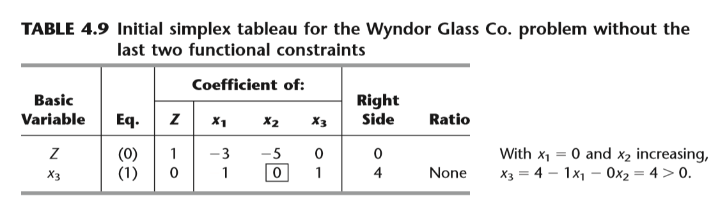
4.5 Tie Breaking in the Simplex Method
If X₂的系数变为-2，？

Slide 46
Tie Breaking in the Simplex Method
Multiple optimal solutions
Simplex method stops after one optimal BF solution is found
Often other optimal solutions exist and would be meaningful choices
Method exists to detect and find other optimal BF solutions

Slide 47

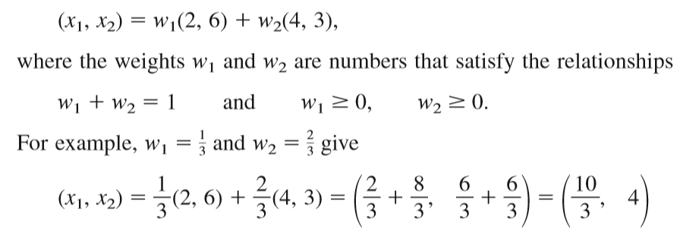
Tie Breaking in the Simplex Method
Multiple optimal solutions

Slide 48
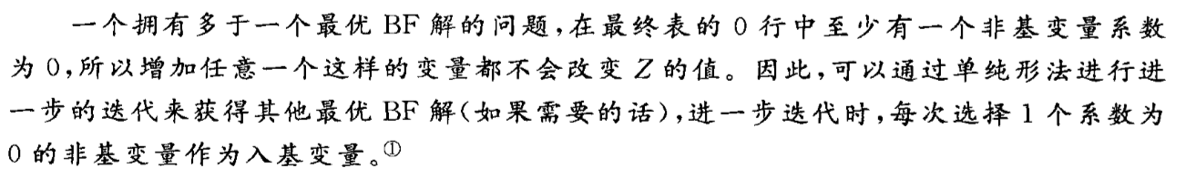
Tie Breaking in the Simplex Method
Multiple optimal solutions
Whenever a problem has more than one optimal BF solution, at least one of the nonbasic variables has a coefficient of zero in the final row 0, so increasing any such variable will not change the value of Z. Therefore, these other optimal BF solutions can be identified (if desired) by performing additional iterations of the simplex method, each time choosing a nonbasic variable with a zero coefficient as the entering basic variable.

Slide 49
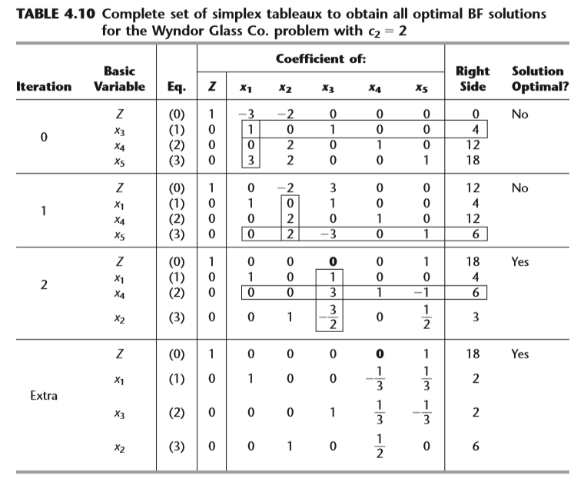

Slide 50
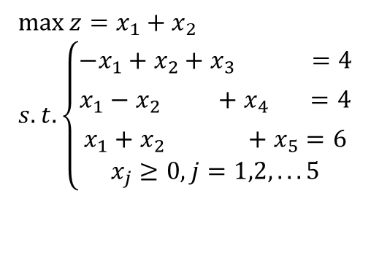
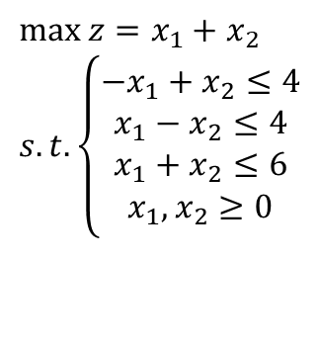
Multiple optimal solutions
$$\max{z}=x_{1}+x_{2} \\ s.t.\left\{\begin{aligned}−x_{1}+x_{2}≤4 \\ x_{1}−x_{2}≤4 \\ x_{1}+x_{2}≤6 \\ x_{1},x_{2}≥0\end{aligned}\right.$$
(1,5)
(5,1)
解: 化成标准形式
$$\max{z}=x_{1}+x_{2} \\ s.t.\left\{\begin{aligned}−x_{1}+x_{2}+x_{3} =4 \\ x_{1}−x_{2} +x_{4} =4 \\ x_{1}+x_{2} +x_{5}=6 \\ x_{j}≥0,j=1,2,...5\end{aligned}\right.$$
填入单纯形表求解

Slide 51
 |  |  | 1 | 1 | 0 | 0 | 0
C_{B} | X_{B} | b | x₁ | x₂ | x₃ | x₄ | x₅
0 | x₃ | 4 | -1 | 1 | 1 | 0 | 0
0 | x₄ | 4 | 1 | -1 | 0 | 1 | 0
0 | x₅ | 6 | 1 | 1 | 0 | 0 | 1
θ
4
6
σ_{j} | 0 | 1 | 1 | 0 | 0 | 0
1
1 | x₂ | 4 | -1 | 1 | 1 | 0 | 0
0 | x₄ | 8 | 0 | 0 | 1 | 1 | 0
0 | x₅ | 2 | 2 | 0 | -1 | 0 | 1
σ_{j} | -4 | 2 | 0 | -1 | 0 | 0
10
8
1 | x₂ | 5 | 0 | 1 | 1/2 | 0 | 1/2
0 | x₄ | 8 | 0 | 0 | 1 | 1 | 0
1 | x₁ | 1 | 1 | 0 | -1/2 | 0 | 1/2
σ_{j} | -6 | 0 | 0 | 0 | 0 | -1
1 | x₂ | 1 | 0 | 1 | 0 | -1/2 | 1/2
0 | x₃ | 8 | 0 | 0 | 1 | 1 | 0
1 | x₁ | 5 | 1 | 0 | 0 | 1/2 | 1/2
σ_{j} | -6 | 0 | 0 | 0 | 0 | -1

Slide 52
最优解X¹=(1,5,0,8,0)^{T}，最优值6。
最优解X²=(5,1,8,0,0)^{T}，最优值6。
实际上X¹与X²的连线上的任意点都是最优解.
(1,5)
(5,1)

Slide 53
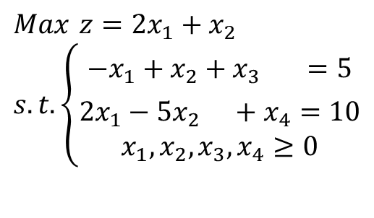
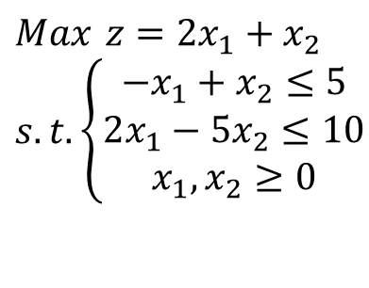
用单纯形法求解线性规划问题（无有限最优解的情况）
$$Max z=2x_{1}+x_{2} \\ s.t.\left\{\begin{aligned}−x_{1}+x_{2}≤5 \\ 2x_{1}−5x_{2}≤10 \\ x_{1},x_{2}≥0\end{aligned}\right.$$
（0，5）
解：化成标准形（典式）
$$Max z=2x_{1}+x_{2} \\ s.t.\left\{\begin{aligned}−x_{1}+x_{2}+x_{3} =5 \\ 2x_{1}−5x_{2} +x_{4}=10 \\ x_{1},x_{2},x_{3},x_{4}≥0\end{aligned}\right.$$
（5，0）

Slide 54
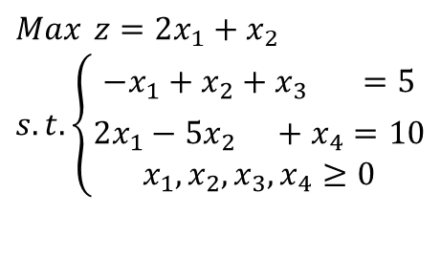
$$Max z=2x_{1}+x_{2} \\ s.t.\left\{\begin{aligned}−x_{1}+x_{2}+x_{3} =5 \\ 2x_{1}−5x_{2} +x_{4}=10 \\ x_{1},x_{2},x_{3},x_{4}≥0\end{aligned}\right.$$
 |  |  | 2 | 1 | 0 | 0
C_{B} | X_{B} | b | x₁ | x₂ | x₃ | x₄
0 | x₃ | 5 | -1 | 1 | 1 | 0
0 | x₄ | 10 | 2 | -5 | 0 | 1
θ
5
σ_{j} | 0 | 2 | 1 | 0 | 0
0 | x₃ | 10 | 0 | -3/2 | 1 | 1/2
2 | x₁ | 5 | 1 | -5/2 | 0 | 1/2
σ_{j} | -10 | 0 | 6 | 0 | -1
X₂的检验数为正，但约束条件中x₂的系数全为负，因此该问题无有限最优解。

Slide 55
4.6 Adapting to Other Model Forms
Simplex method adjustments
Needed when problem is not in standard form
Made during initialization step
Artificial-variable technique人工变量
Dummy variable 虚拟变量introduced into each constraint that needs one
Becomes initial basic variable for that equation

Slide 56
Adapting to Other Model Forms
Types of nonstandard forms
Equality constraints
Negative right-hand sides
Functional constraints in greater-than-or-equal-to form
Minimizing Z
Solving the radiation therapy problem
Text reviews two methods: Big M and two-phase

Slide 57
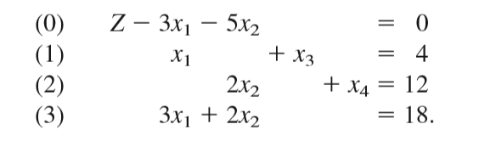
Adapting to Other Model Forms
Equality constraints

Slide 58
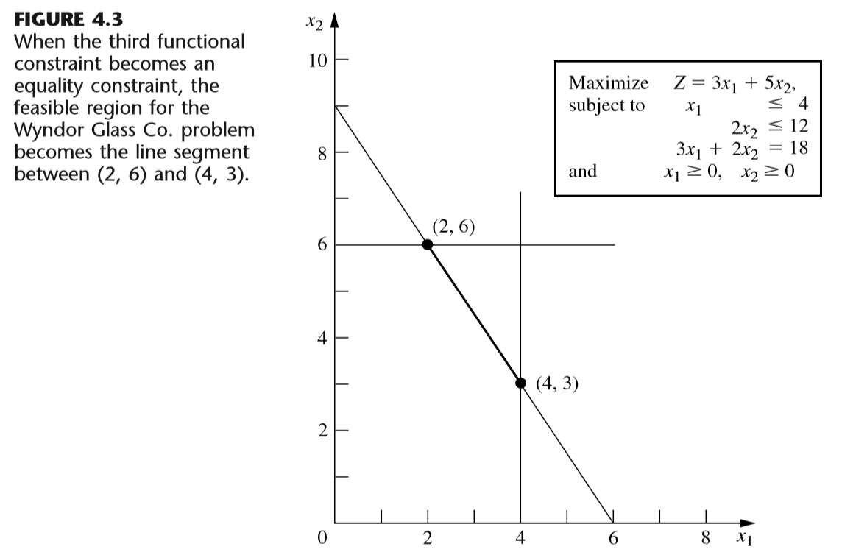
Adapting to Other Model Forms

Slide 59
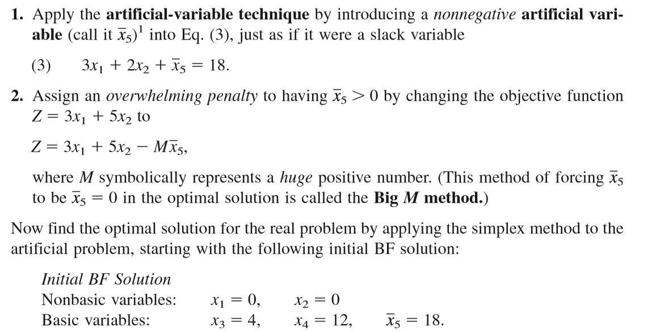
Adapting to Other Model Forms
Obtaining an Initial BF Solution

Slide 60
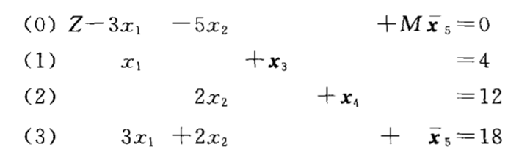
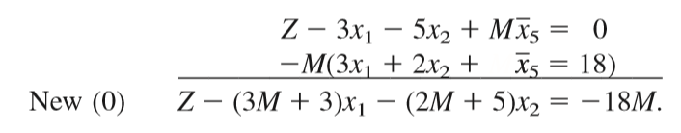
Adapting to Other Model Forms
Obtaining an Initial BF Solution

Slide 61
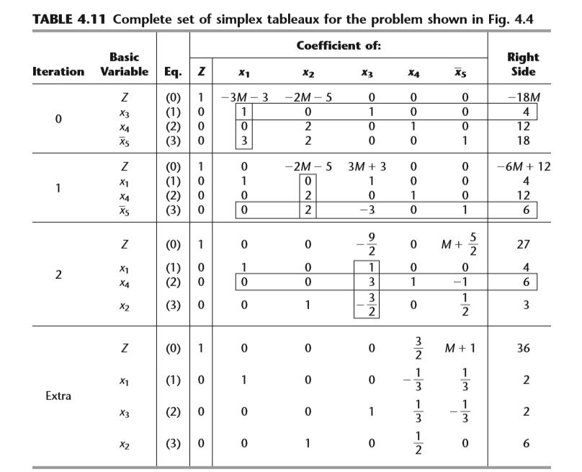

Slide 62


Adapting to Other Model Forms
Negative Right-Hand Sides

Slide 63
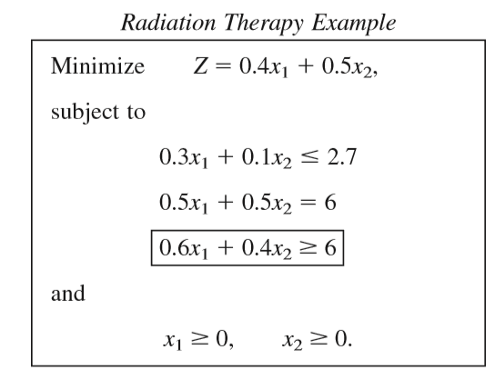
Adapting to Other Model Forms
Functional Constraints in ≥ Form

Slide 64
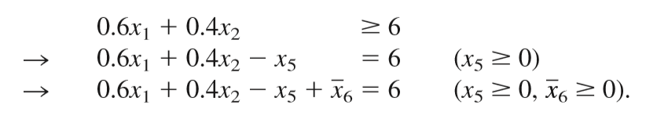
Adapting to Other Model Forms
Functional Constraints in ≥ Form
x5 is called a surplus variable

Slide 65
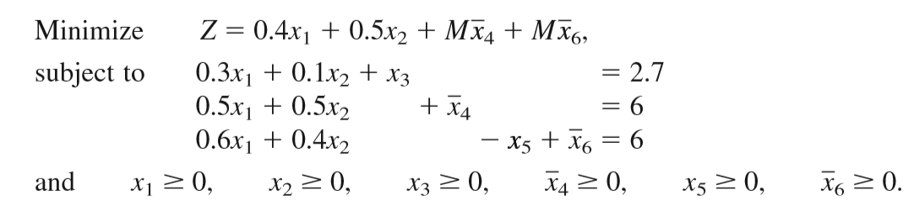
Adapting to Other Model Forms
Functional Constraints in ≥ Form
Note ： the coefficients of the artificial variables in the objective function are +M

Slide 66
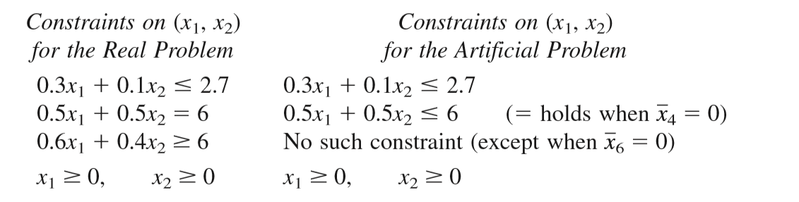
Adapting to Other Model Forms
Functional Constraints in ≥ Form

Slide 67
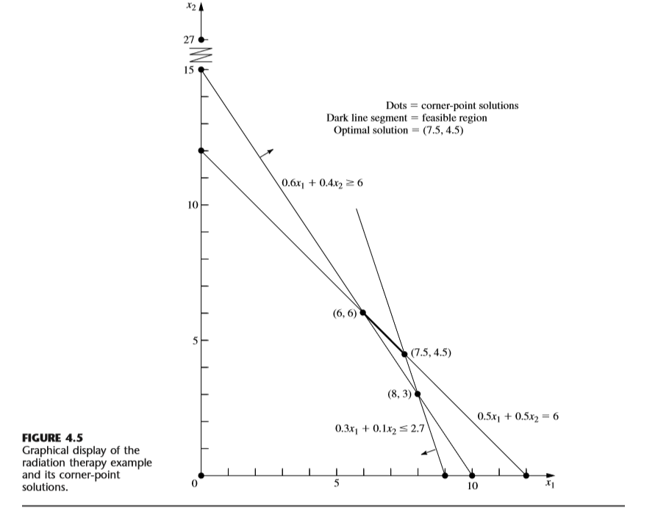

Slide 68



Adapting to Other Model Forms
Minimization

Slide 69


Adapting to Other Model Forms
Solving the Radiation Therapy Example

Slide 70

Adapting to Other Model Forms
Solving the Radiation Therapy Example

Slide 71


Slide 72



Exercise
$$\max{z}=−3x_{1}+x_{3} \\ \left\{\begin{aligned} x_{1}+x_{2}+x_{3}≤4 \\ −2x_{1}+x_{2}−x_{3}≥1 \\ 3x_{2}+x_{3}=9 \\ x_{1},x_{2},x_{3}≥0\end{aligned}\right.$$
$$\max{z}=−3x_{1}+x_{3} \\ \left\{\begin{aligned} x_{1}+x_{2}+x_{3}+x_{4} =4 \\ −2x_{1}+x_{2}−x_{3} −x_{5}=1 \\ 3x_{2}+x_{3} =9 \\ x_{j}≥0,j=1,...5\end{aligned}\right.$$
化标准型
$$\max{z}=−3x_{1}+x_{3}−Mx_{6}−Mx_{7} \\ \left\{\begin{aligned} x_{1}+x_{2}+x_{3}+x_{4} =4 \\ −2x_{1}+x_{2}−x_{3} −x_{5}+x_{6} =1 \\ 3x_{2}+x_{3} +x_{7}=9 \\ x_{j}≥0,j=1,...7\end{aligned}\right.$$

Slide 73
 |  |  | -3 | 0 | 1 | 0 | 0 | -M | -M
C_{B} | X_{B} | b | x₁ | x₂ | x₃ | x₄ | x₅ | x₆ | x₇
0 | x₄ | 4 | 1 | 1 | 1 | 1 | 0 | 0 | 0
-M | x₆ | 1 | -2 | 1 | -1 | 0 | -1 | 1 | 0
-M | x₇ | 9 | 0 | 3 | 1 | 0 | 0 | 0 | 1
θ
4
1
3
σ_{j} | 10M | -2M-3 | 4M | 1 | 0 | -M | 0 | 0
0 | x₄ | 3 | 3 | 0 | 2 | 1 | 1 | -1 | 0
1
1
0 | x₂ | 1 | -2 | 1 | -1 | 0 | -1 | 1 | 0
-M | x₇ | 6 | 6 | 0 | 4 | 0 | 3 | -3 | 1
σ_{j} | 6M | 6M-3 | 0 | 4M+1 | 0 | 3M | -4M | 0
0 | x₄ | 0 | 0 | 0 | 0 | 1 | -1/2 | 1/2 | -1/2
9
3/2
0 | x₂ | 3 | 0 | 1 | 1/3 | 0 | 0 | 0 | 1/3
-3 | x₁ | 1 | 1 | 0 | 2/3 | 0 | 1/2 | -1/2 | 1/6
σ_{j} | 3 | 0 | 0 | 3 | 0 | 3/2 | -M-3/2 | -M+1/2
0 | x₄ | 0 | 0 | 0 | 0 | 1 | -1/2 | 1/2 | -1/2
0 | x₂ | 5/2 | -1/2 | 1 | 0 | 0 | -1/4 | 1/4 | 1/4
1 | x₃ | 3/2 | 3/2 | 0 | 1 | 0 | 3/4 | -3/4 | 1/4
σ_{j} | -3/2 | -9/2 | 0 | 0 | 0 | -3/4 | -M+3/4 | -M-1/4

Slide 74


Adapting to Other Model Forms
The Two-Phase Method

Slide 75

Adapting to Other Model Forms
The Two-Phase Method
Initialization: Revise the constraints of the original problem by introducing artificial variables as needed to obtain an obvious initial BF solution for the artificial problem.

Slide 76

Adapting to Other Model Forms
The Two-Phase Method

Slide 77

Adapting to Other Model Forms
The Two-Phase Method

Slide 78


Slide 79


Slide 80


Slide 81


Slide 82
Adapting to Other Model Forms
The Two-Phase Method
Table 4.13: a tie in phase 1 ?

Slide 83

Exercise
Using the two-phase method to solve the problem

Slide 84

Exercise

Slide 85

Exercise

Slide 86
Adapting to Other Model Forms
No feasible solutions
Constructing an artificial feasible solution may lead to a false optimal solution伪最优解
Artificial-variable technique provides a way to indicate whether this is the case
Variables are allowed to be negative
Example: negative value indicates a decrease in production rate
Negative values may have a bound or no bound

Slide 87

Adapting to Other Model Forms
No feasible solutions

Slide 88


Adapting to Other Model Forms
No feasible solutions

Slide 89


Slide 90


Adapting to Other Model Forms
Variables are allowed to be negative
where L_{j} is some negative constant

Slide 91


Adapting to Other Model Forms
Variables are allowed to be negative

Slide 92

Adapting to Other Model Forms
Variables with No Bound on the Negative Values Allowed

Slide 93

Adapting to Other Model Forms
Variables with No Bound on the Negative Values Allowed

Slide 94

Adapting to Other Model Forms
Variables with No Bound on the Negative Values Allowed

Slide 95

4.7 Postoptimality Analysis
Simplex method role

Slide 96
Postoptimality Analysis
Reoptimization
Alternative to solving the problem again with small changes
Involves deducing how changes in the model get carried along to the final simplex tableau
Optimal solution for the revised model:
Will be much closer to the prior optimal solution than to an initial BF solution constructed the usual way

Slide 97
Postoptimality Analysis
Shadow price
Measures the marginal value of resource i
The rate at which Z would increase if more of the resource could be made available
Given by the coefficient of the i^{th} slack variable in row 0 of the final simplex tableau

Slide 98


Slide 99

Postoptimality Analysis
Shadow price

Slide 100


Slide 101

Postoptimality Analysis
Shadow price
Once b2 is increased beyond 18, the optimal solution stays at (0, 9) with no further increase in Z.
？
Scarce goods 稀缺资源
Surplus goods

Slide 102
Postoptimality Analysis
Sensitivity analysis
Purpose: to identify the sensitive parameters
These must be estimated with special care
Can be done graphically if there are just two variables
Can be performed in Microsoft Excel

Slide 103

Postoptimality Analysis

Slide 104
Postoptimality Analysis
Parametric linear programming
Study of how the optimal solution changes as many of the parameters change simultaneously over some range
Used for investigation of trade-offs in parameter values
Technique presented in Section 8.2

Slide 105
4.8 Computer Implementation
Simplex method ideally suited for execution on a computer
Computer code for the simplex method
Widely available for all modern systems
Follows the revised simplex method
Main factor determining time to solution
Number of functional constraints
Rule of thumb: number of iterations required equals twice the number of functional constraints

Slide 106
4.9 The Interior-Point Approach to Solving Linear Programming Problems
Alternative to the simplex method developed in the 1980s
Far more complicated
Uses an iterative approach starting with a feasible trial solution
Trial solutions are interior points
Inside the boundary of the feasible region
Advantage: large problems do not require many more iterations than small problems

Slide 107

The Interior-Point Approach to Solving Linear Programming Problems

Slide 108
The Interior-Point Approach to Solving Linear Programming Problems
Disadvantage
Limited capability for performing a postoptimality analysis
Approach: switch over to simplex method

Slide 109
4.10 Conclusions
Simplex method
Efficient and reliable approach for solving linear programming problems
Algebraic procedure
Efficiently performs postoptimality analysis
Moves from current BF solution to a better BF solution
Best performed by computer except for the very simplest problems

